Slide 1
Libraries and Variables
WEEK 2
Lesson #1
(Revision)

Slide 2
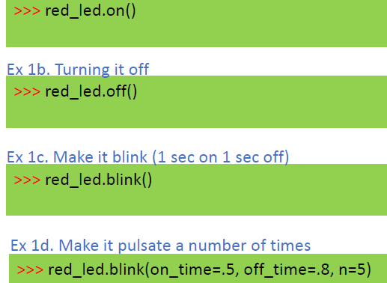

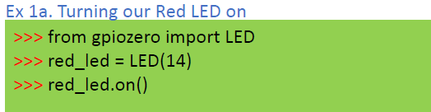
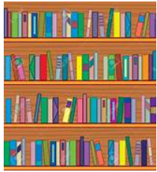
Recall Ex 1a.
Ex 1a. Turning our Red LED on
>>> from gpiozero import LED
>>> red_led = LED(14)
>>> red_led.on()
Notes:
Thonny IDE has two areas to run code
What is the difference?

Slide 3
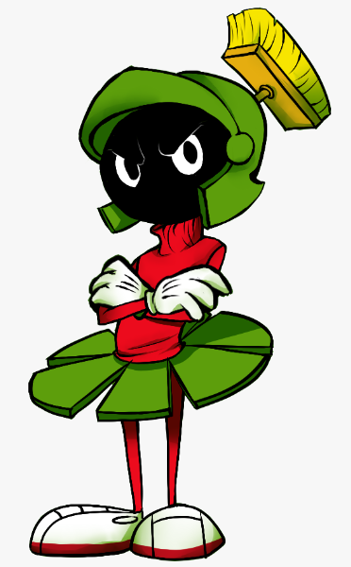
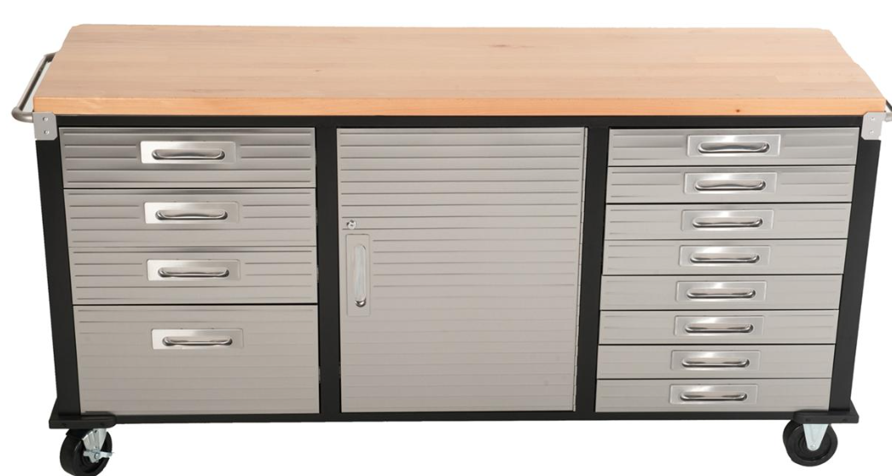
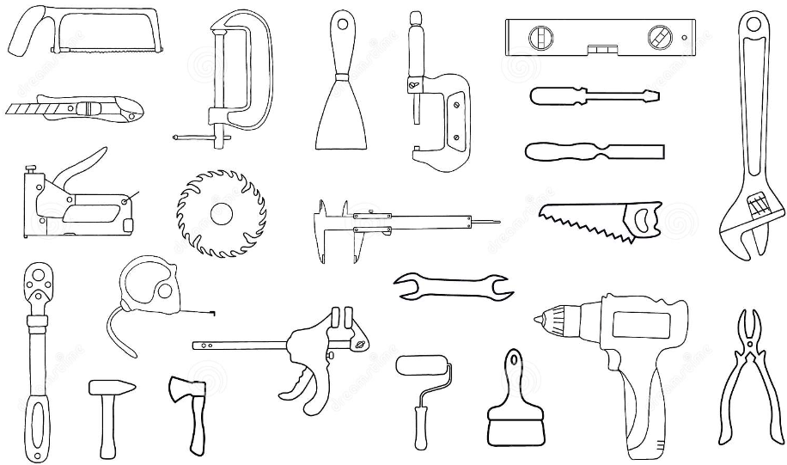
Revision
from TOOLBOX import DRILL
Alien from Planet Python needs a drill to fix his spacecraft.
You have a drill in your toolbox that you can lend him.
BUT he only speaks Python language.
How will you let him know he can borrow your drill?
Hint: from gpiozero import LED
TOOLBOX
DRILL

Slide 4
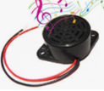
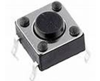
The gpiozero Library
from gpiozero import LED
What other tools can we find in the gpiozero LIBRARY
Buzzer
from gpiozero import Buzzer
Button
from gpiozero import Button
from gpiozero import LED, Buzzer, Button

Slide 5
FUNCTIONS
WEEK 2
Lesson #1

Slide 6
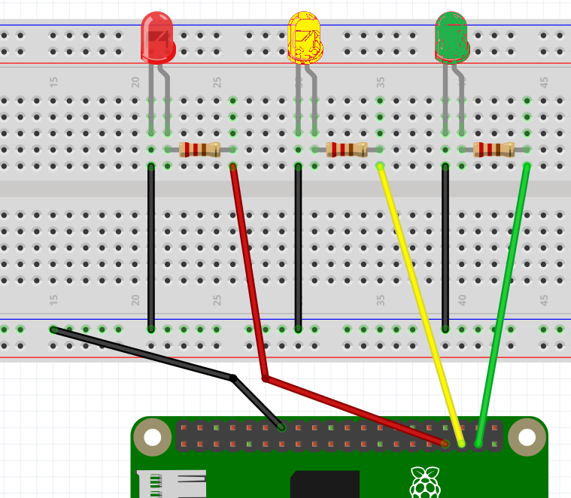


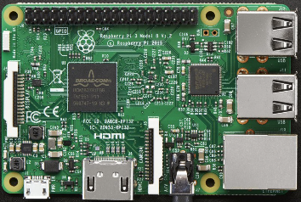

EXERCISE #2
Wiring for a Traffic Light
GROUND
PIN 13
PIN 19
PIN 26

Slide 7
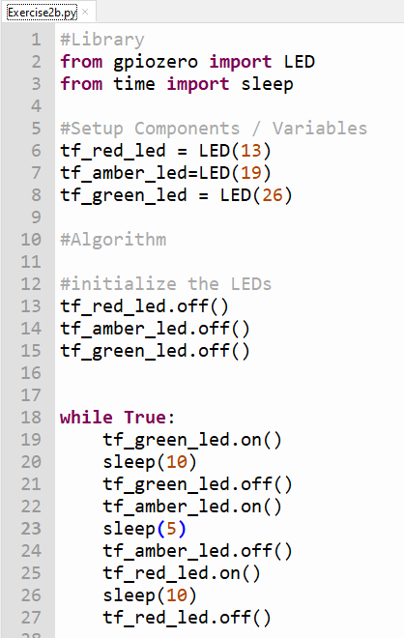
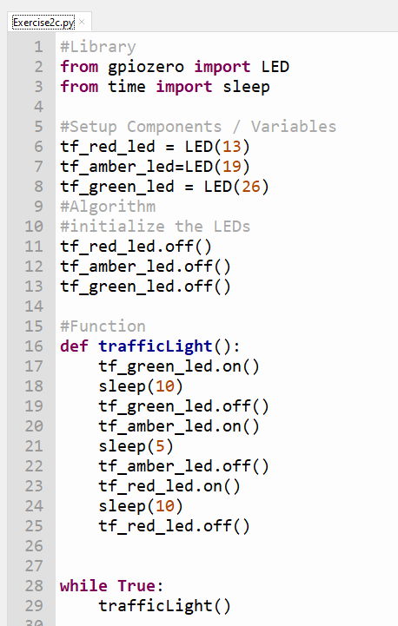
WEEK 2
Ex. 2b Traffic Light in a Loop (Exercise2b.py)
Ex. 2c Traffic Light as a Function (Exercise2c.py)
Functionalize

